Slide 1


TNC18 Update
SIG-Marcomms, CSC, Espoo, Finland
Rosanna Norman, GÉANT, 13-03-18
www.geant.org

Slide 2

New Brand, New Theme

Slide 3
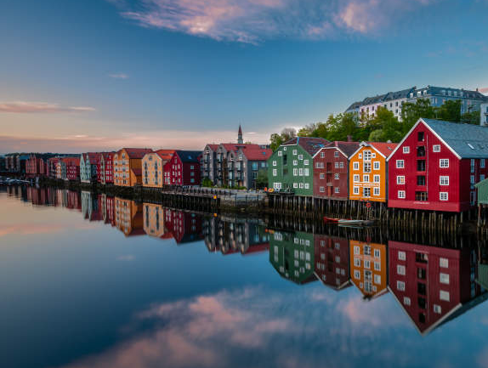
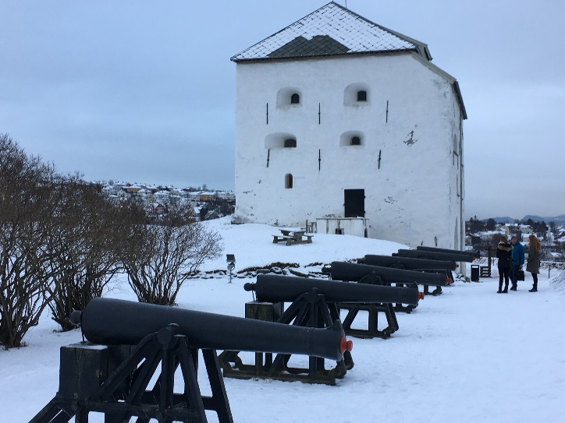
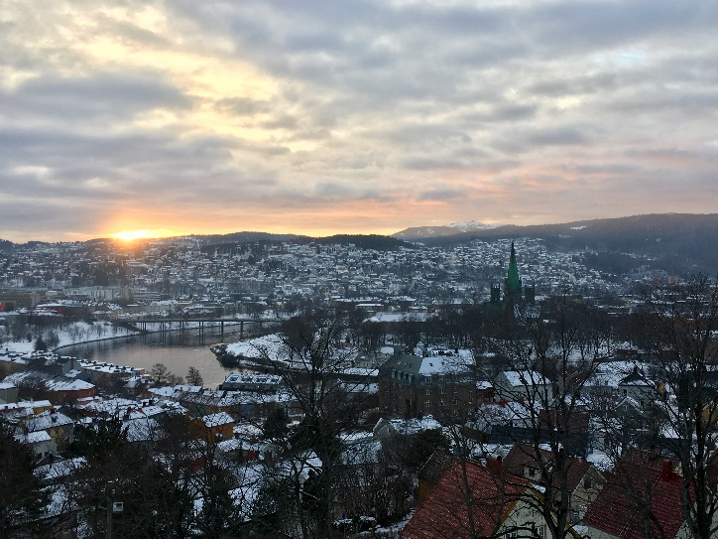
New Amazing Location: Trondheim
Notes:
This picks up an old discussion between telcos and Internet people about how to build and interconnect networks.

Slide 4
Intelligent networks, cool edges?
Theme
Intelligent networks presumes that there is a place for complexity in the network
Arctic coolness and the internet principle of end-to-end traffic, where all the cool stuff is at the edges
How do the edges interconnect? Should the edges be the place where everything happens?
Sub-themes
The power of the internet
Responsible sustainability and delivery
The power of data analytics
Creating intelligent complexity
Networking at the speed of science
Notes:
June could be anything from +5 degrees to +25 in Trondheim, but most likely everything in between, with an average of +15 Celsius. Trondheim is on the coast, and has variable weather.
This picks up an old discussion between telcos and Internet people about how to build and interconnect networks.
The power of the Internet is transforming research and education. Networks are needed everywhere. Sustainable delivery of an infrastructure connecting devices and people with continuing exponential growth is a challenge.
Responsible sustainability and delivery Sustainable delivery of an infrastructure connecting devices and people with continuing exponential growth is a challenge. Global and local aspects, green ICT and blackouts, privacy and sharing. Share your efforts on securing data, infrastructure and users.
The power of data analytics enables us to get the intelligence out of the network. Data collection must respect social and technical restrictions to ensure security and privacy. How is the digital transformation changing our responsibilities towards data? How data is used (or underused?) for communicating performance, value, trouble or excellence.
Creating intelligent complexity. The research networks connect the smartest people on Earth with each other, with the open Internet and with devices of every imaginable kind. Sometimes the network needs to move extremely large amounts of data, fast, sometimes it needs to delve deep into very challenging places.
Networking at the speed of science is needed to keep up with researchers. TNC18 wants to hear from individuals with inspiring stories about uncommon R&E network challenges, or with learning experiences arising from the consolidation of everyday operations.

Slide 5
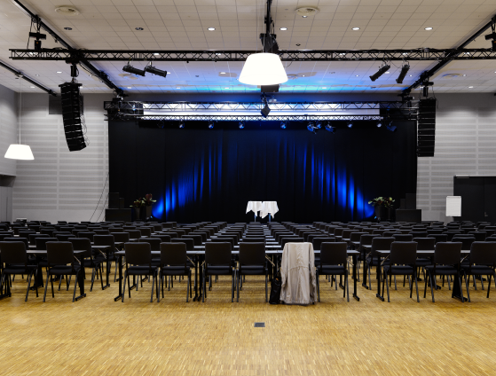
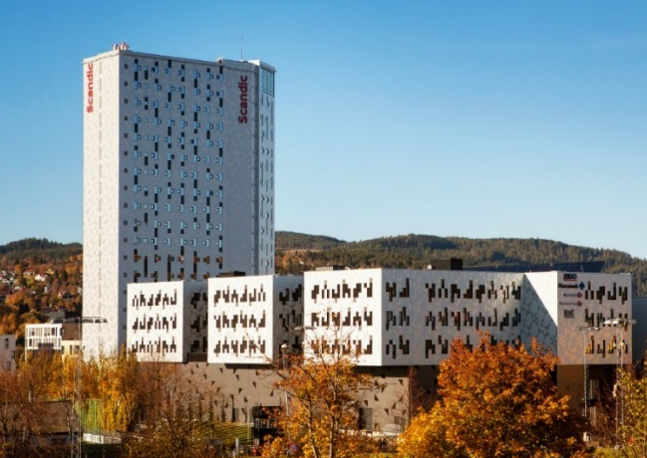
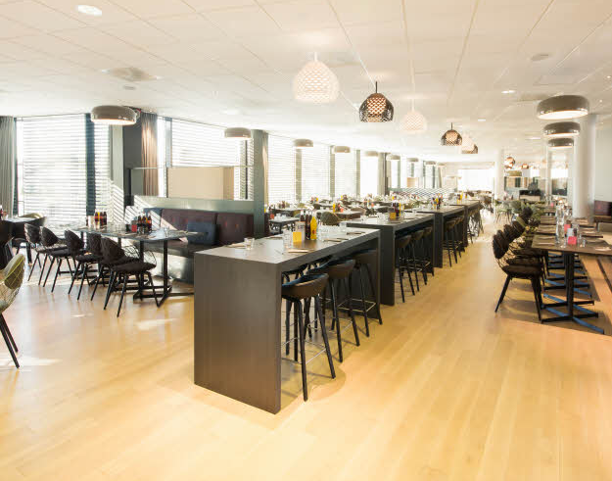
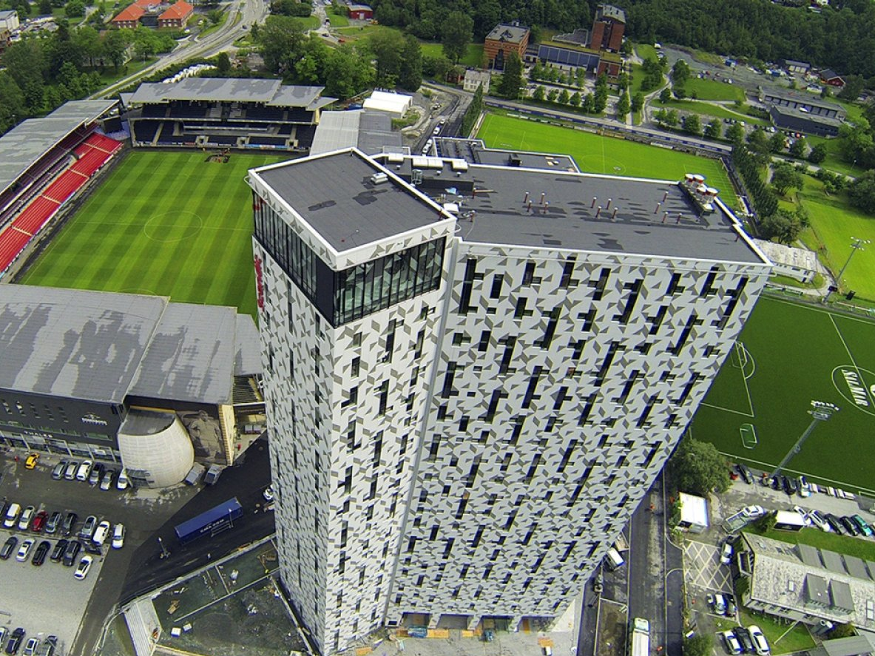
Venue: Scandic Lerkendal

Slide 6
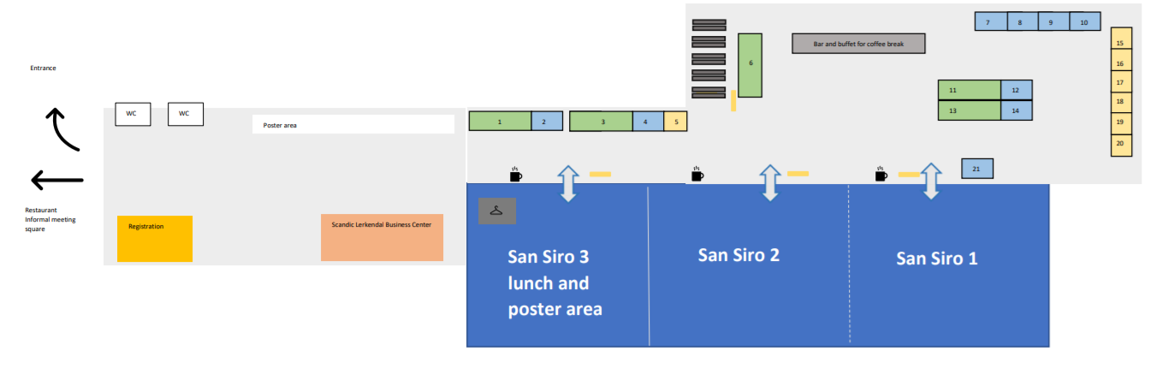
Venue lay out – ground floor

Slide 7
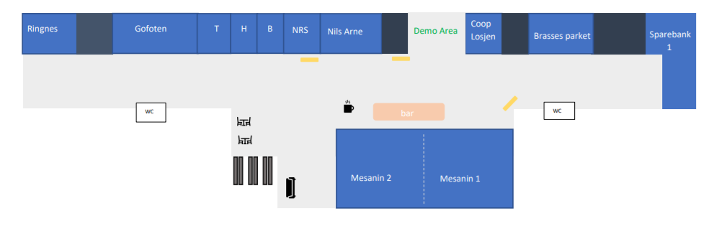
Venue lay out – first floor

Slide 8
Facts and figures
50
20
121
6
24
437
Side meeting requests submitted
Demonstrations submitted
Proposals for sessions / presentations submitted
Confirmed keynote speakers
Sessions created
Paying participants registered to date

Slide 9
Sponsors – confirmed and signed to date
PLATINUM
CIENA
ECI
Google
Nordunet
GOLD
OwnCloud
Dropbox
SILVER
ADVA
FlexOptix
Extreme Networks
CORSA
BRONZE
RIPE
PSNC

Slide 10
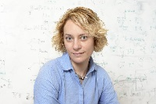
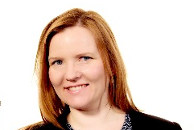
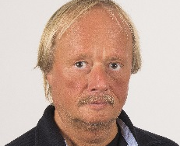
Keynote Speakers - tnc18.geant.org
Stephanie Wehner – OPENING PLENARY
Professor in Quantum Information, Technical University of Delft, The Netherlands. Stephanie’s presentation will introduce us to the world of quantum internet. What is quantum-based internet good for? Why is quantum communication so powerful? What does quantum communication change about the way we communicate?
Marie Moe – OPENING PLENARY
Research Scientist at SINTEF ICT, and an Associate Professor at the Norwegian University of Science and Technology. Her keynote speech focuses on her current research on the security of her own personal critical infrastructure, an implanted pacemaker that is generating every single beat of her heart.
Helge Stranden
Senior Advisor on ICT and HPC physical infrastructure at UNINETT, Norway. His keynote address will feature live video footage from UNINET’s subsea cable project where 2x270 kilometres of optic cable was laid on the seabed outside Svalbard, an arctic archipelago located between mainland Norway and the North Pole.

Slide 11
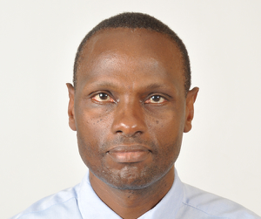
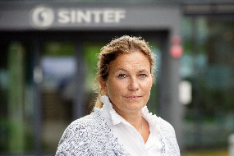
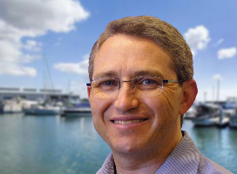
Keynote Speakers - tnc18.geant.org
Meoli Kashorda
Executive Director of Kenya Education Network (KENET) and Professor of information systems at United States International University - Africa (USIU). His keynote presentation will describe how KENET in Kenya that has been able to overcome the obstacles of lack of adequate road/electricity infrastructures, limited penetration of fibre networks, and low network engineering skills to build a high-speed network.
Alexandra Bech Gjørv
President and CEO of SINTEF, Norway. Alexandra’s keynote presentation focuses on the impact of digital transformation on research organisations and the everyday research and on all its scientists and researchers.
Andrew Woods – CLOSING PLENARY
Senior Research fellow at Curtin University in Western Australia.
Andrew’s keynote address presents the Sydney-Kormoran Project, a multidisciplinary project combining deep-water imaging, supercomputing, image processing, advanced visualisation and history to tell the story of two of Australia’s most significant shipwrecks.

Slide 12
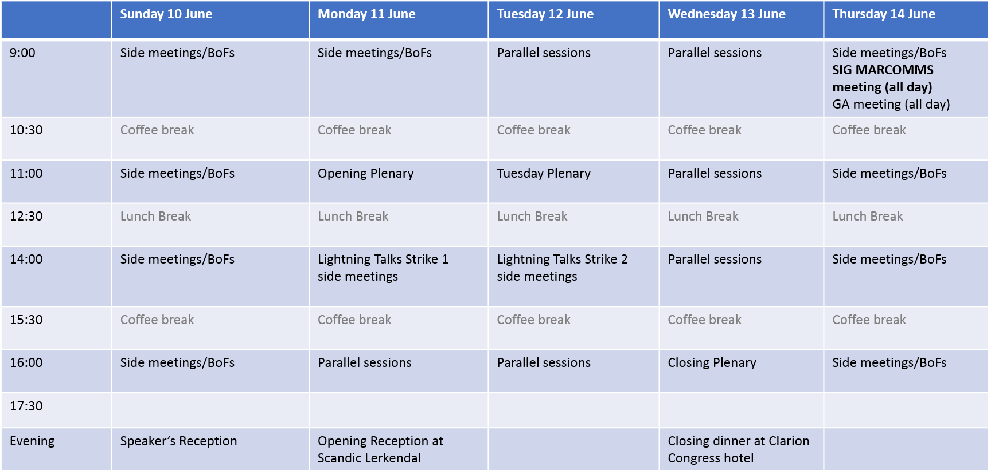
Programme overview - tnc18.geant.org

Slide 13
Social events
Speakers’ Reception – Sunday 10 June
18:00 -19:30 - Speakers and Programme Committee at UNINETT Office - by invitation only
Opening Reception – Monday 11 June
17:30 – 19:00 - Scandic Lerkendal (drinks and snacks)
19:30 - Organ concert offered by Trondheim City Council in the beautiful Nidaros Cathedral
Closing dinner – Wednesday 13 June
20:00 – 23:00 hrs - Clarion Congress Hotel - hosted by UNINETT

Slide 14
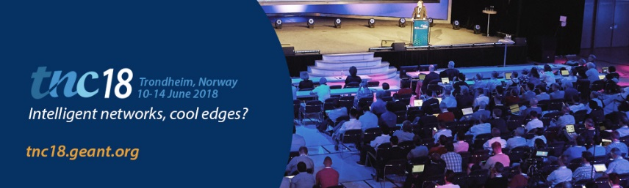

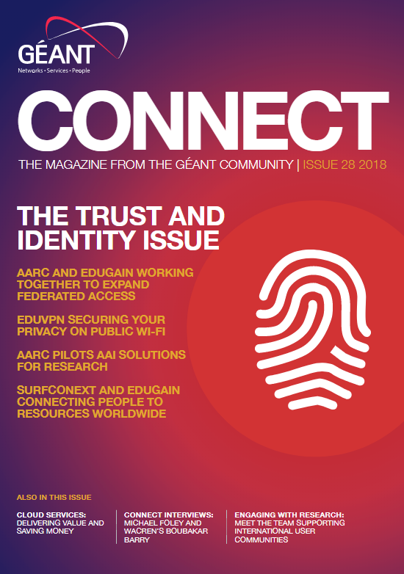
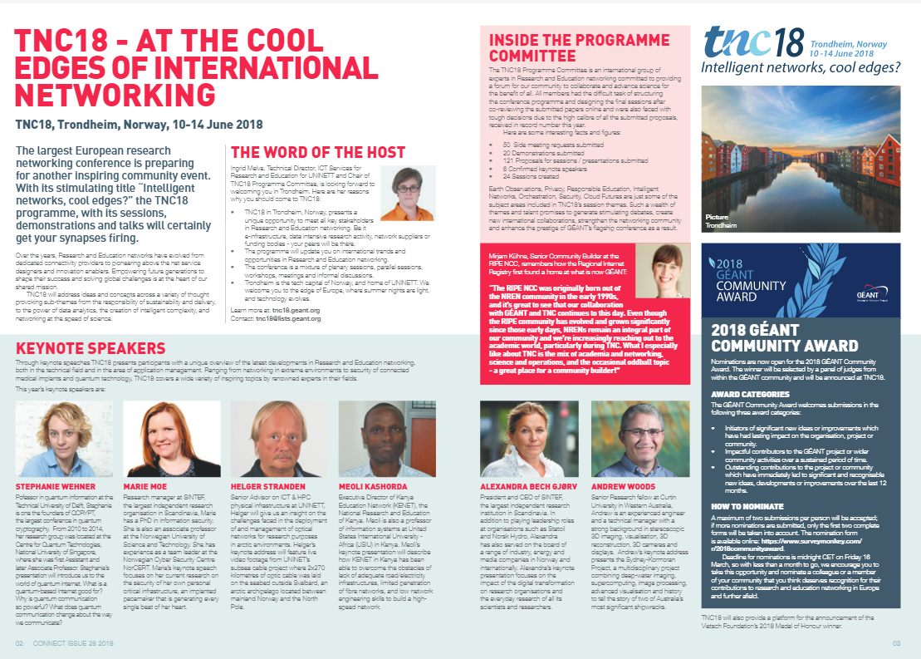


Promotion - tnc18.geant.org
Notes:
Banners, Email comms, social media, twitter TNC18 handle, preview on CONNECT#28, CONNECT #29 entirely dedicated to TNC18, Community Award

Slide 15
More information - tnc18.geant.org
Next Deadlines
Community Award
16 March 2018
https://www.surveymonkey.com/r/2018communityaward
Posters and Lighning Talks
16 April 2018
Participate on tnc.geant.org
More info
More about the programme
Schedule on tnc18.geant.org
Registration:
Online registration until 1 June 2018 only
Register on tnc18.geant.org
Hotel bookings:
For special rates go to:
Venue, Hotels on tnc18.geant.org

Slide 16
Contacts - tnc18.geant.org
Logistics & Programme
Steffie Bosman - Steffie.Bosman@geant.org
Jessie Brockhoff - Jessie.Brockhoff@geant.org
Exhibition
Anna Everitt - Anna.Everitt@geant.org
Marcomms
Rosanna Norman - Rosanna.Norman@geant.org
Sponsorship
Karl Meyer – Karl.Meyer@geant.org
Sponsorship logistics
Jessie Brockhoff – jessie.brockhoff@geant.org

