Slide 1
CESNET New brand
Ilona Trtíková
CESNET
March 2018

Slide 2
New Brand
New logo
New sub-logos
Graphic manual
New typeface AVENIR (=future)

Slide 4
Internal launch
INTERNAL
7. 12. 2017 - Breakfast for employees - 6 locations – connection via videoconference
Employee got t-shirt and business cards
The old logo was replaced in our premises the night before
There was Xmas party in the evening

Slide 5
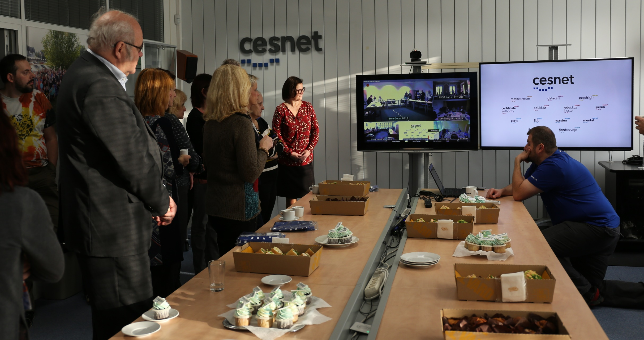

Slide 6
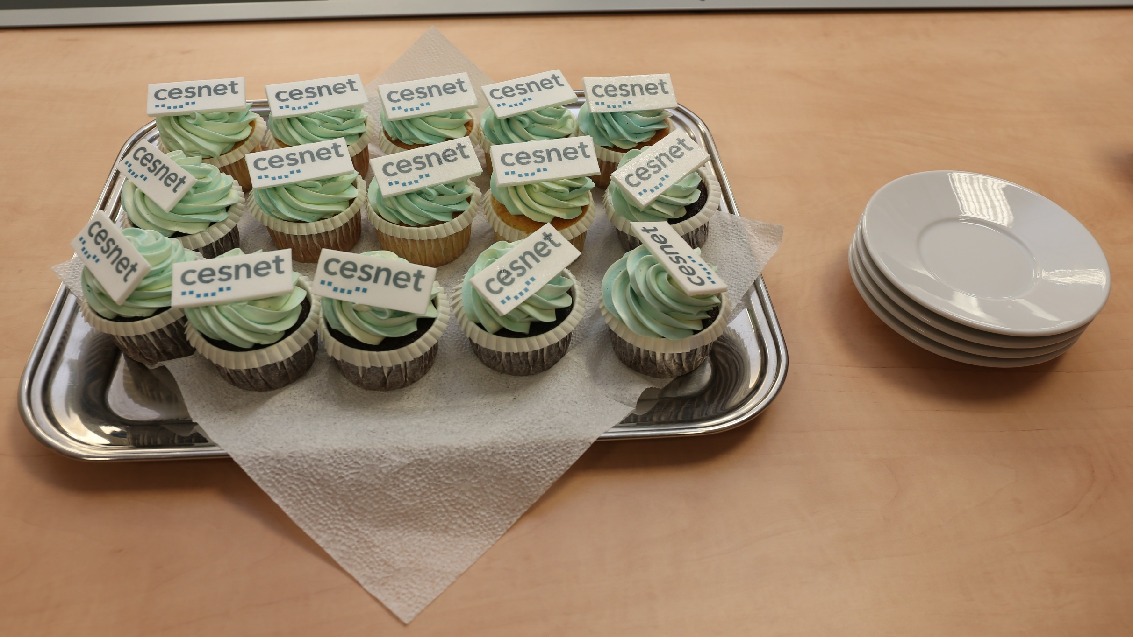

Slide 7
EXternal launch
National conference – 11. 12. 2017
New design – posters, presentations, leafleats, demos, roll ups …..
Night before conference – new webpages , social networks
VIDEO describing the process of logo creation
  https://www.youtube.com/watch?v=iO3xGL3Zq-k
  and printed brochure

Slide 8
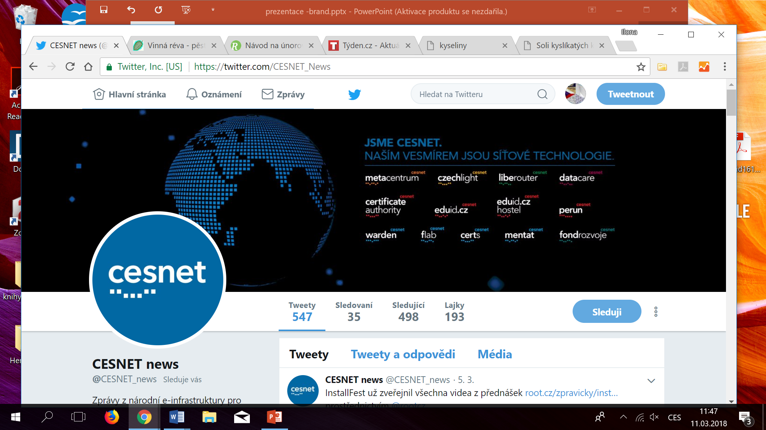

Slide 9
THANK YOU

