Slide 1
Social Media Advertising:
Is it worth it?
Ela Yazdani | TNC18 – Global Marcomms & PR | June 14, 2018

Slide 2
Why advertise at all?
Improve brand recognition among end users so that they buy more of our things.

Slide 3
But in the case of NRENs…
Promote brand to show value to end users:
- Improve uptake of programs & services
- Develop new advocates
- Build credibility as experts in our domain

Slide 4
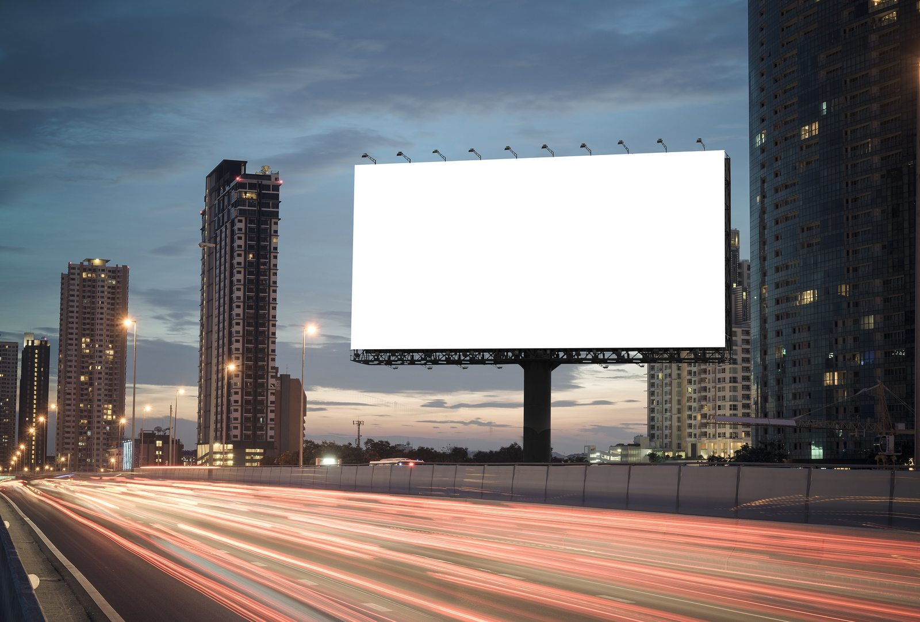
Why not regular advertising channels?
Difficult to target.
Expensive.
Engagement level is unclear.
Difficult to measure.

Slide 5

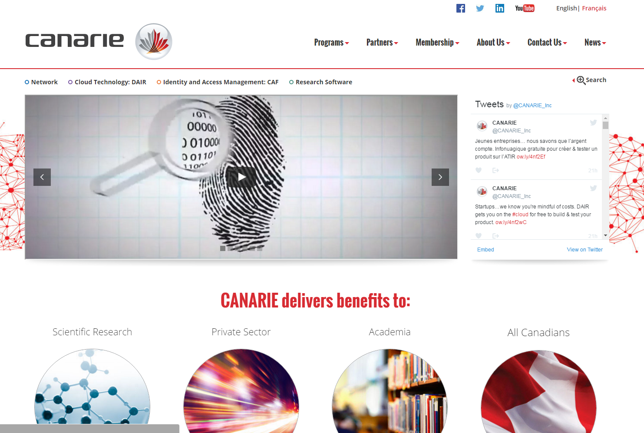








What are we promoting?
Press Releases
Website, Blogs
Social Followers
Videos
Events
Case Studies, Fact Sheets

Slide 6
How did we start?
$50 at first.
$50 free credits!
3-month pilot
1 full learning year
Notes:
$50 buys allowed us to see if this would even work.
Pilot gave us an idea of pricing.
Charter to define what we wanted to achieve based on the pricing we found.

Slide 7
Here’s what happened.

Slide 8
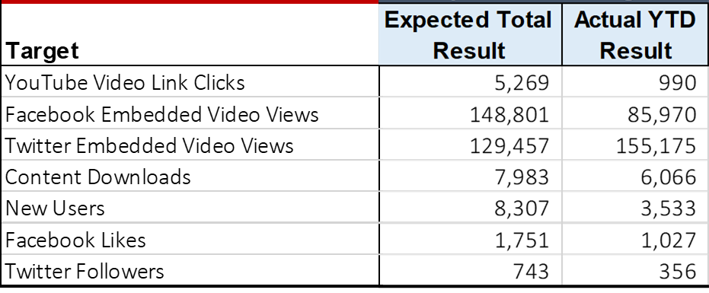
Social Media Expected vs. Results

Slide 9
Social Media Followers – FY14 – FY18

Slide 10
What we’ve learned…
Simple, human interest stories; discoveries
Opinions, news/bulletins
Corporate announcements, partnerships
Notes:
Facebook & Twitter don’t want to lose people to Google.
Embedded videos is very inexpensive
Advertising YouTube videos is VERY expensive

Slide 11

What we’ve learned…
If you show the right people the content that they care about,
they might actually read it…
maybe they’ll even share it.
Notes:
If they follow them, they will want to follow us.

Slide 12


What we’ve learned…
Notes:
Facebook & Twitter don’t want to lose people to Google.
Embedded videos is very inexpensive
Advertising YouTube videos is VERY expensive

Slide 13

What we learned…
People have very short attention spans. So…
Text + Image
Video
Text

Slide 14


What we’ve learned…
Notes:
Facebook & Twitter don’t want to lose people to Google.
Embedded videos is very inexpensive
Advertising YouTube videos is VERY expensive

Slide 15

What we’ve learned…
has additional benefits…
Notes:
Facebook & Twitter don’t want to lose people to Google.
Embedded videos is very inexpensive
Advertising YouTube videos is VERY expensive

Slide 16

What we’ve learned…
We
data.
Notes:
Determines what works, what doesn’t, what people are into, what they don’t care about
Helps justify $ to management
Keeps us agile

Slide 17


Slide 18
ela.yazdani@canarie.ca

