Slide 1
What’s More Fun Than Stakeholder Metrics?
Ela Yazdani | TNC18 – Global Marcomms & PR | June 14, 2018
Get in touch: @ela_yazdani

Slide 2
It started with a couple of simple questions…
Who are our key stakeholders?
How do they engage with us?
Are we improving our engagement over time?

Slide 3

Who are our stakeholders?
Private Sector
Higher Education
Regional Networks / Global NRENs
Federal Government
Research Labs & Innovation Parks
Key Individuals

Slide 4
What are the indicators that are relevant for us to measure?
NREN CONNECTION
CANARIE MEMBER
NETWORK TRAFFIC
RESEARCH SOFWARE CALL PARTICIPANT
FEDERATED IDENTITY PARTICIPANT
EDUROAM PARTICIPANT
They each get a score of 0 or 1.
JOINT SECURITY PROJECT PARTICIPANT
SUBSCRIBER TO CANARIE NEWS
TWITTER FOLLOWER

Slide 5
Then came the hard part.
Where is the data?
Who owns this data?
How to go from all our spreadsheets
to a single, interactive, useful dashboard?
Do we have the right tools?

Slide 6
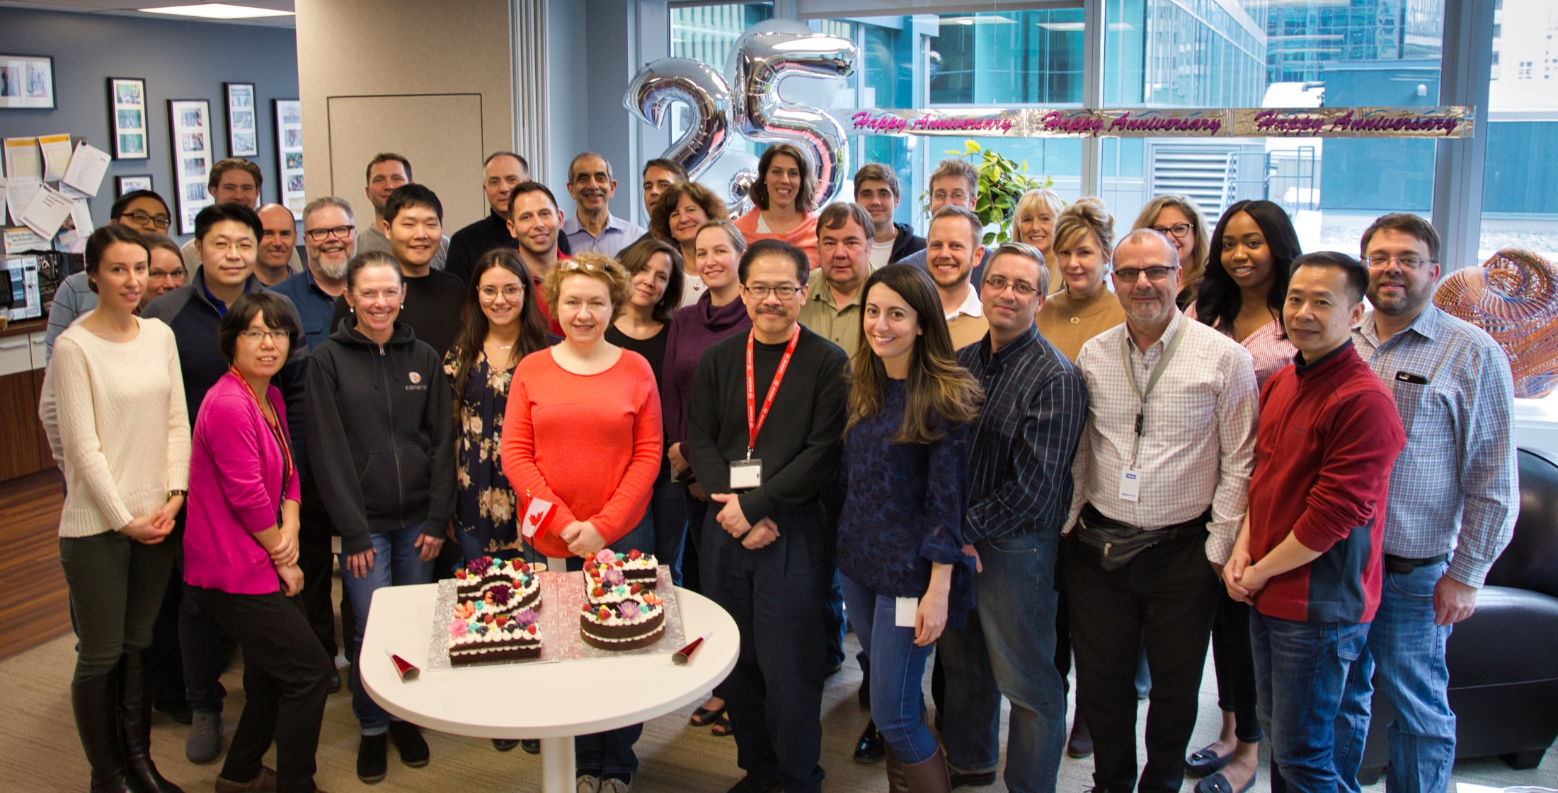
Also…
Who is going to figure this out?
Comms Coordinator / Researcher Extraordinaire
Analytics Manager / Data Scientist Extraodinaire

Slide 7

Demo

Slide 8
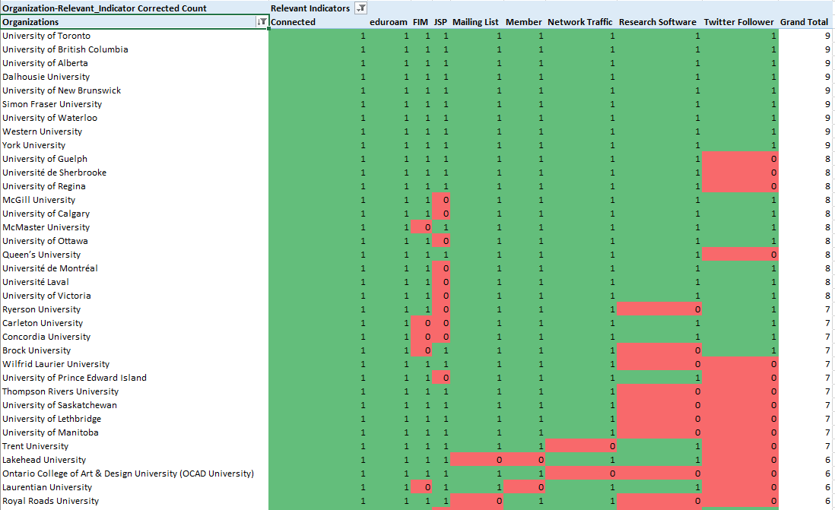
Our “relevance” to Canadian universities
Notes:
Snapshot of heat map – 9 relevant indicators by Universities Canada members

Slide 9
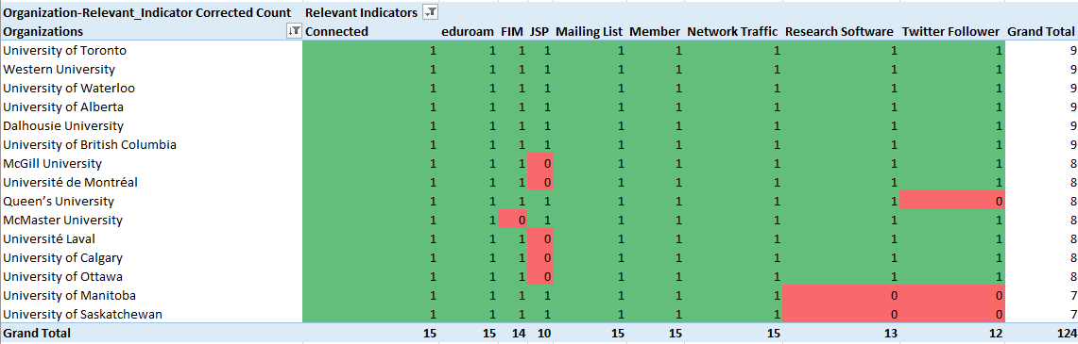
Our relevance to Canada’s top 15 research universities
Notes:
Snapshot of heat map – 9 relevant indicators by U15 members

Slide 10
And how we score with groupings of institutions…
Notes:
Average score per 9 relevant indicators (Connected, eduroam, FIM, JSP, Mailing List, Member, Network Traffic, Research Software, Twitter Follower) by community affiliation and populations:
Please note that the number in bracket is the percentage against the relevant indicator average score
U15 8.3 (92%)
CARL 7.4 (82%)
CUCCIO 6.1 (68%)
Public Universities 5.2 (58%)
Universities Canada 4.5 (50%)
Higher Education institutions 2.9 (32%)
CICan 1.6 (17%)
Private Universities 0.3 (4%)

Slide 11
A few things we learned…
We already have most of the data we need.
Your dashboard is only as good as your data.
Collecting new data can be tedious.
This type of project quickly identifies processes that have room for improvement.
Getting it right takes time. Lots of time.
Checkpoints with exec team are crucial.
Metrics can be A LOT of fun…for the right team.

Slide 12

Add remaining stakeholder organizations
Develop a dashboard for individual stakeholders
Add a time element to all metrics

Slide 13


Slide 14
ela.yazdani@canarie.ca

