Slide 1


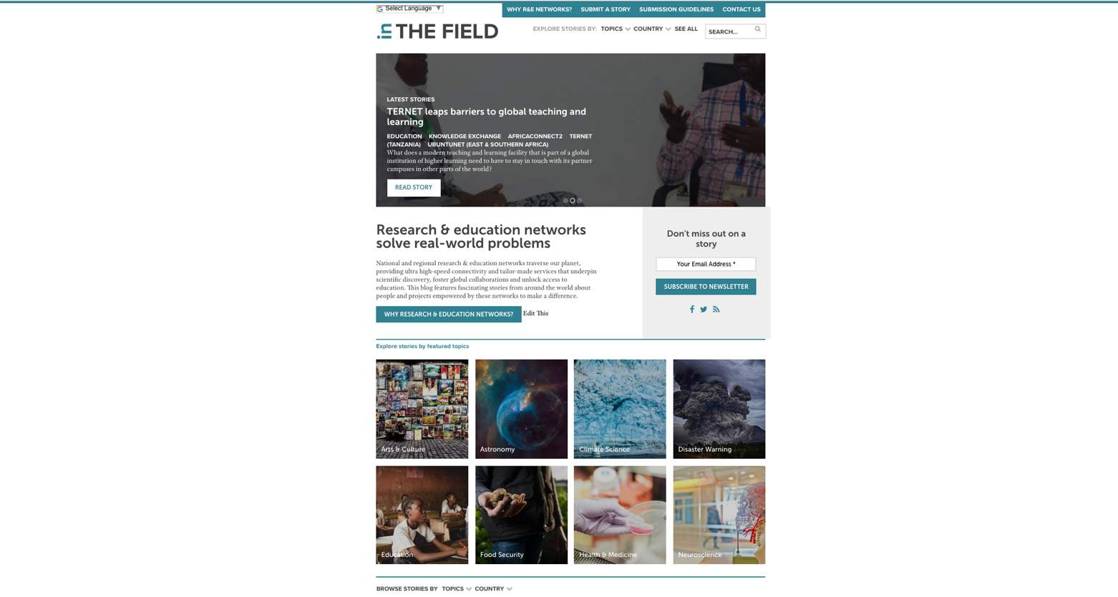

Blog Update
TNC 2018
Jane Gifford, Media & Communications Director
AARNet (Australia’s Academic & Research Network)

Slide 2
Objectives ?
Collaborate
Provide a digital platform as a way for Global PR Network to collaborate
Raise Awareness
Raise awareness of NREN activities and impact regionally and globally
Resource
Build a shared resource of use cases for all NRENs to utilise
People
Provide a glimpse of the human side and societal impact of R&E networking

Slide 3
Timeline
OCT 2016
JUNE 2016
JUNE 2017
OCT 2017
FEEDBACK
SPANISH
NEWSLETTER
NREN community surveyed
+TNC BoF
STORIES
Trial site launched
launched
184
published
LAUNCH
STORIES
STORIES
RELAUNCH
website
+
social media
FEB 2016
83
published
(KPI: 60 stories
by Oct 2017)
AUGUST 2016
140
published
JAN –JUNE 2017
New and improved site
JUNE 2018

Slide 4
Google Analytics Snapshot
25 OCTOBER 2015 TO 12 JUNE 2018
UNIQUE USERS = 23,552
PAGE VIEWS = 58,652
COUNTRIES = 181

Slide 5
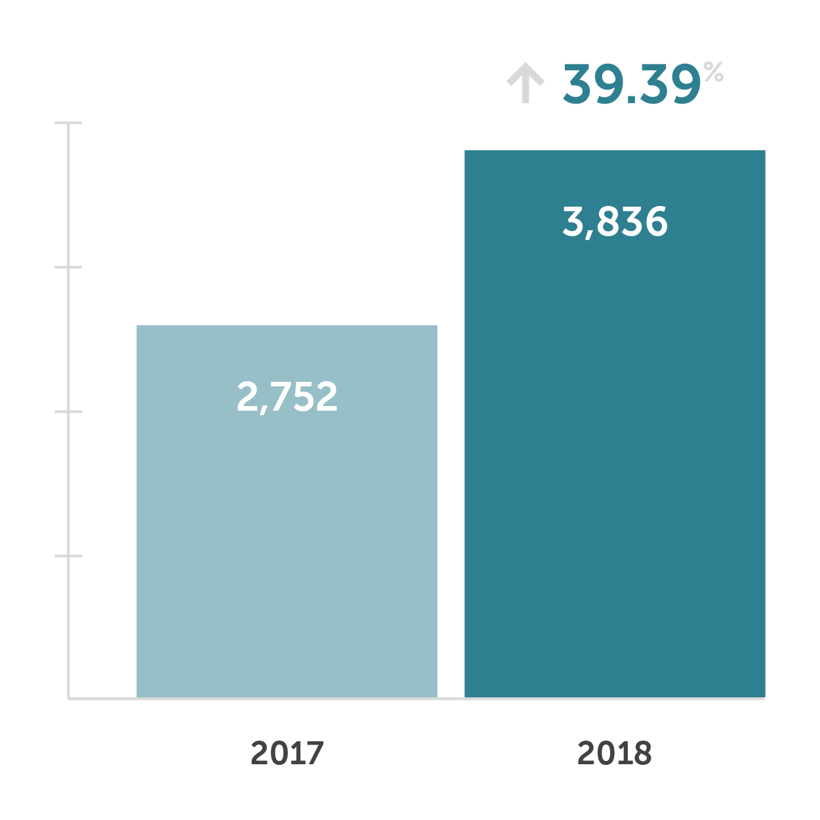
Let’s compare
UNIQUE USERS
Data comparison for the period 1 Jan – 30 April for 2017 and 2018

Slide 6

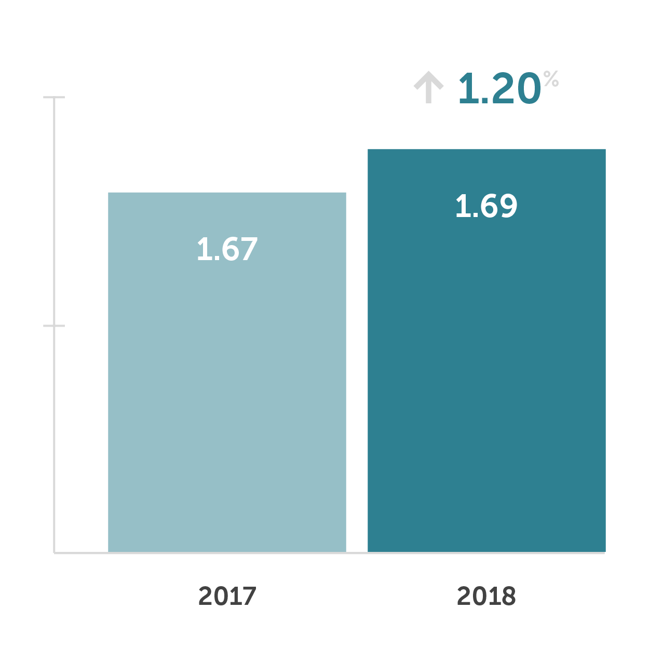
PAGE VIEWS
AVERAGE PAGES/SESSION
Data comparison for the period 1 Jan – 30 April for 2017 and 2018

Slide 7
AVERAGE TIME ON PAGE
AVERAGE SESSION DURATION
Data comparison for the period 1 Jan – 30 April for 2017 and 2018

Slide 8
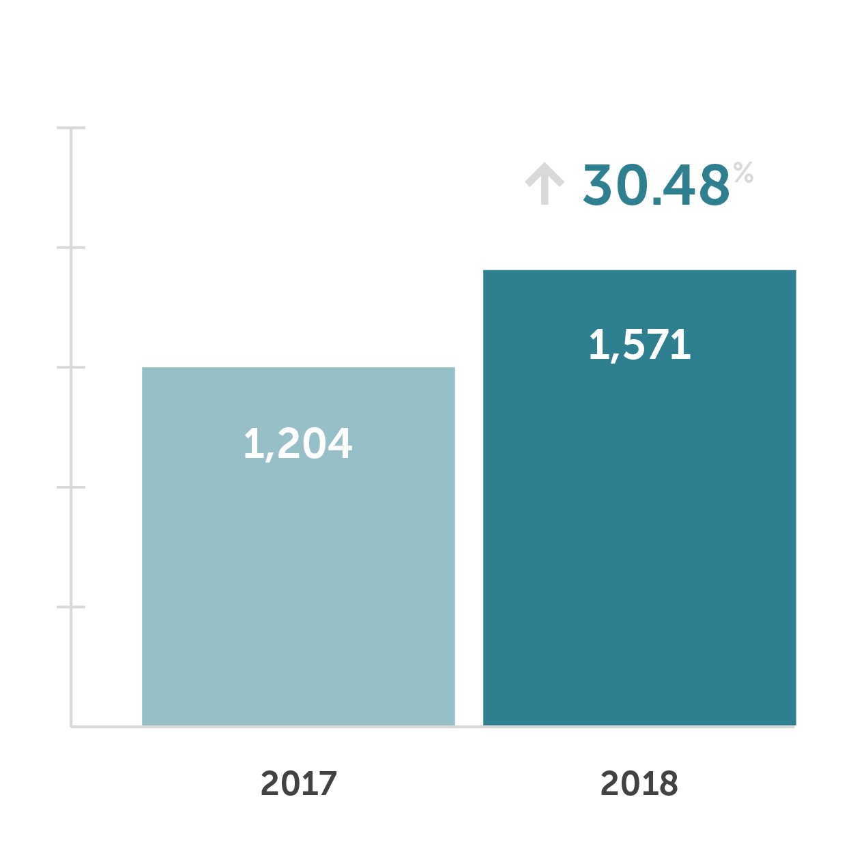
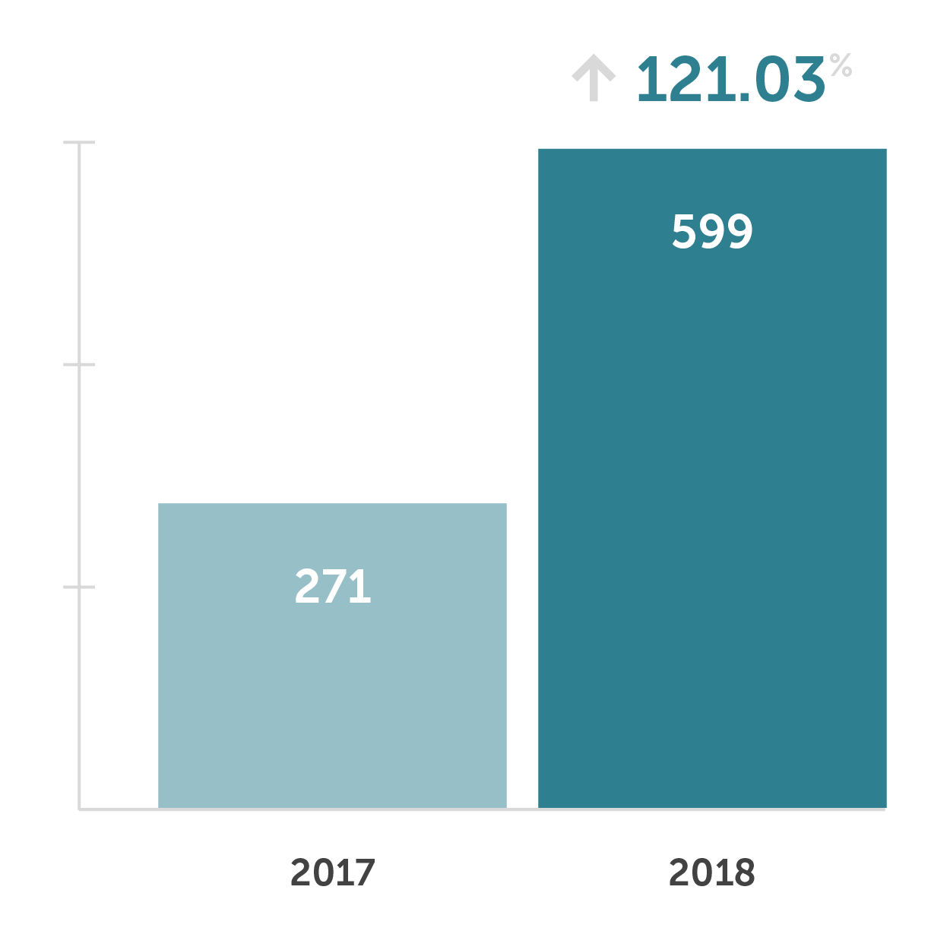
ORGANIC SEARCH
SOCIAL MEDIA
Data comparison for the period 1 Jan – 30 April for 2017 and 2018

Slide 9
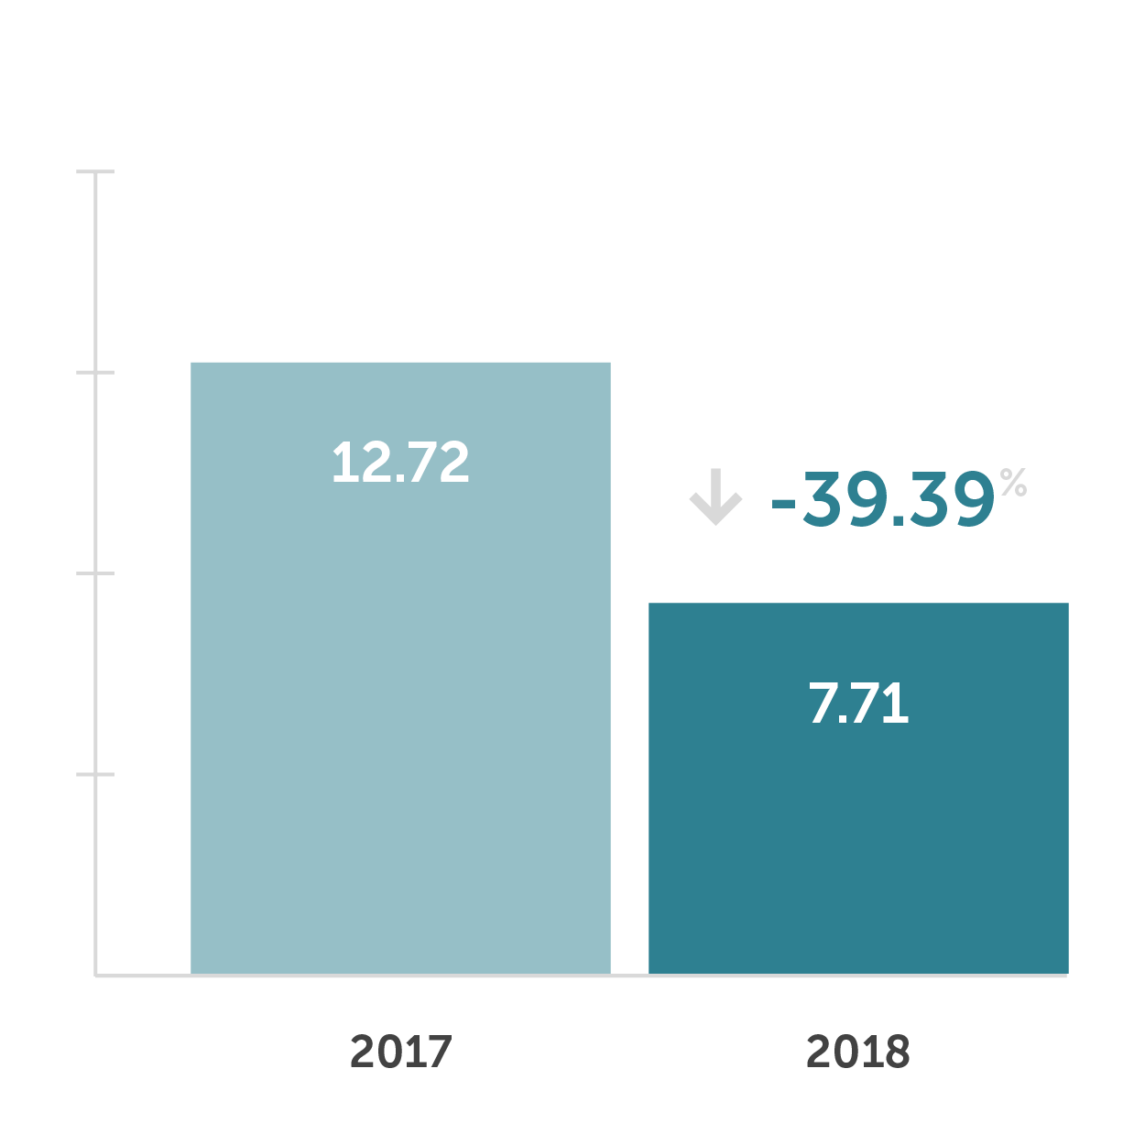
AVERAGE PAGE LOAD TIME
Data comparison for the period 1 Jan – 30 April for 2017 and 2018

Slide 10
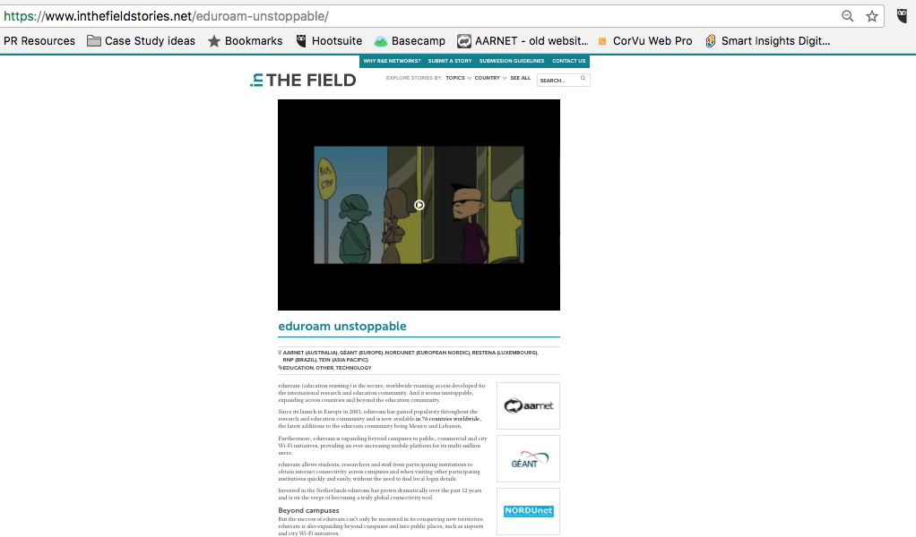
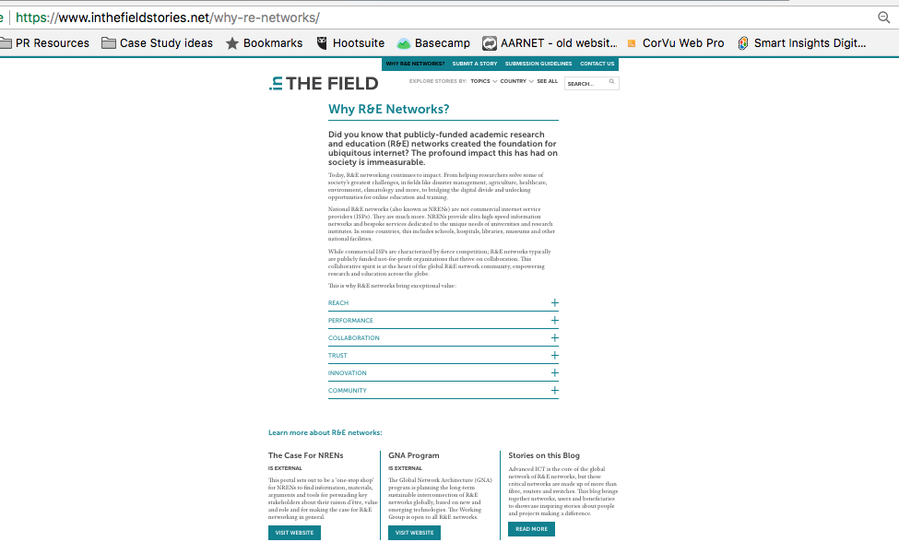
Top posts
EDUROAM UNSTOPPABLE
#1 most popular story of all time
(published April 2016)
WHY R&E NETWORKS
#2 most viewed page of all time
(published Oct 2016)
https://www.inthefieldstories.net/eduroam-unstoppable/
https://www.inthefieldstories.net/why-re-networks/

Slide 11

Newsletter
LAUNCHED AUGUST 2017
SUBSCRIBERS = 283
OPEN RATE = 34.7%
(telco industry benchmark = 21.57%)
CLICK RATE = 6.8%
(telco industry benchmark = 2.43%)

Slide 12
Editorial Team
Jane Gifford (AARNet) – since 2015
Helga Spitaler (GEANT) – since 2015
Dimple Sokatara (GEANT) – since 2017
Audrey Gerber (IUCC) – since 2017
Arne Vollertsen (NORDUnet) – since 2015
inthefieldstories.net

Slide 13
WHAT’S NEXT?

